Slide 1
Amazon Prime Vedios Analysis
File created on: 01-06-2023 00:14:43

Slide 2
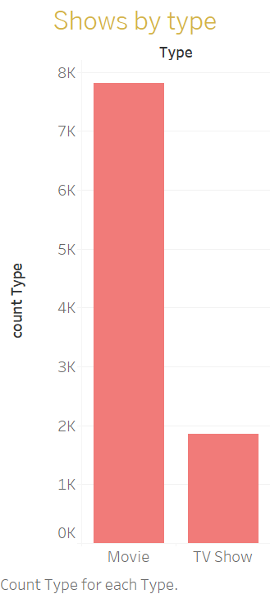

Slide 4
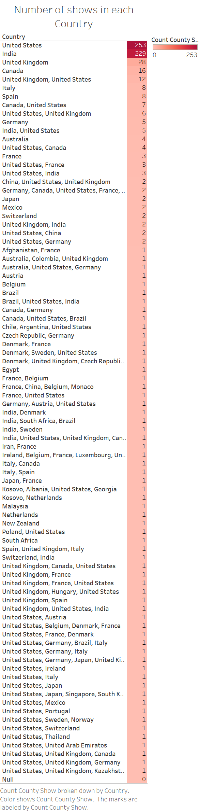

Slide 5
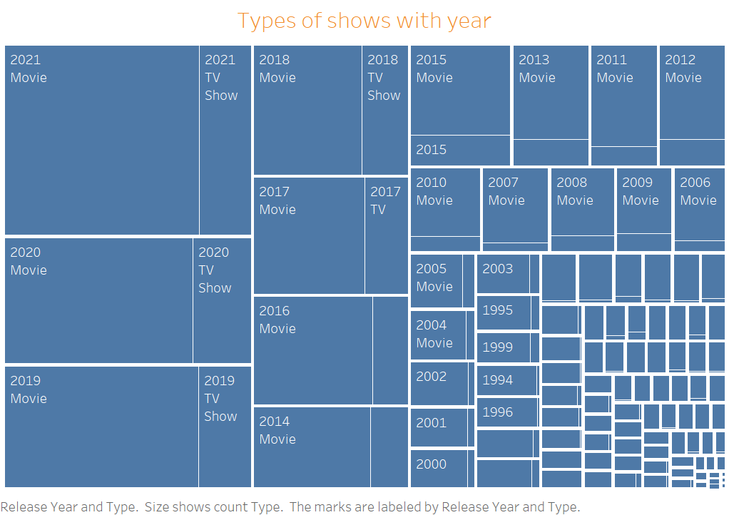

Slide 6
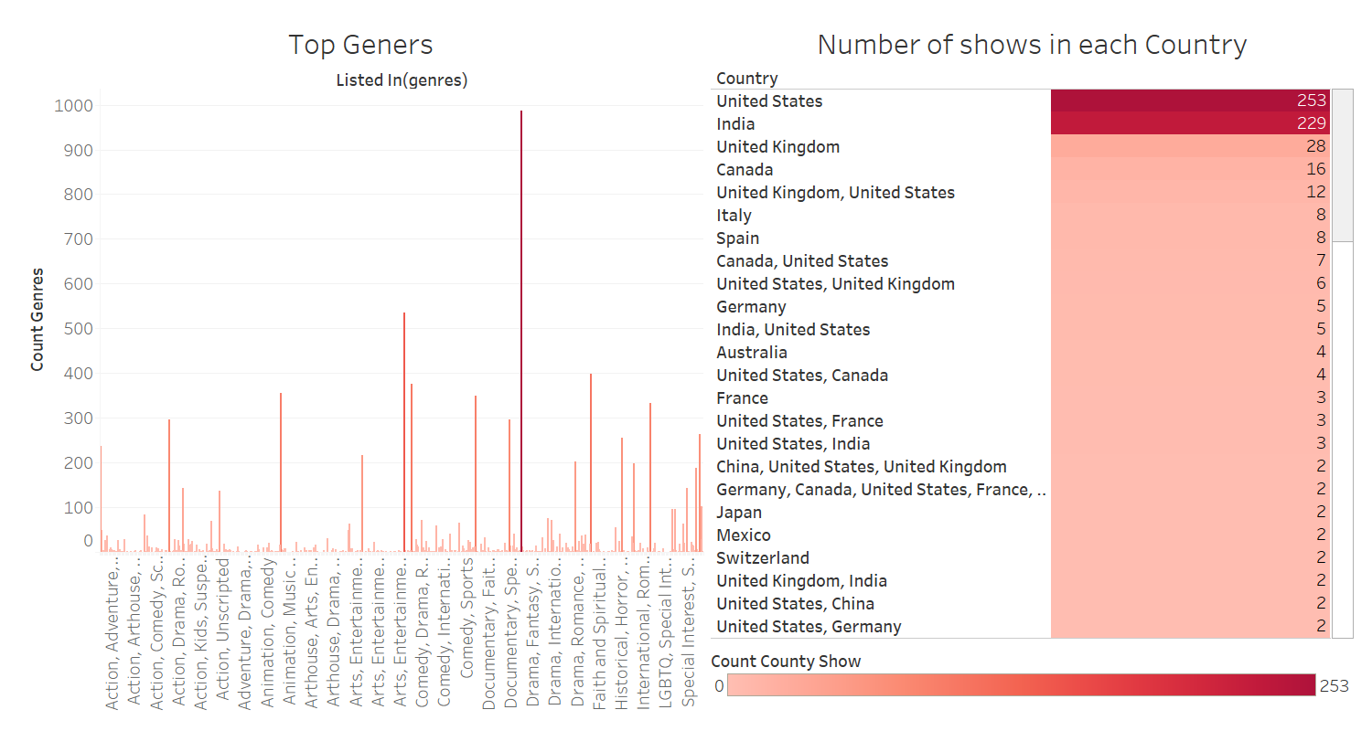

Slide 7
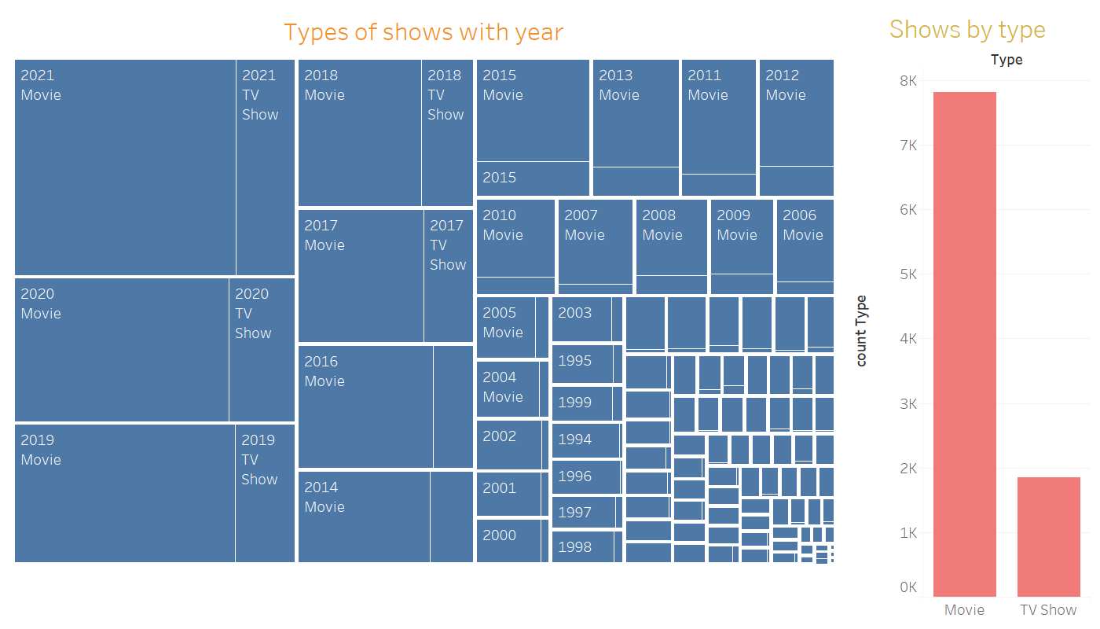

Slide 8


